Slide 1
COMP7615 Selected Topics
Carly Orr

Slide 2
Who Am I?
Carly Orr
BCIT Instructor, School of Computing
Room: SW2-319
Office Hours: Monday 9:30-12:30, Thursday 9:30-11:30, or make appointment by email.
carly_wong_orr@bcit.ca (in subject header, please include name, set, student number).

Slide 3
Topics
Part One: Assembly Language
High-Level-Languages (HLL):
one line of code translates to several lines of machine code
HLL is machine-independent
Assembly language:
one line translates to one line of machine language
AL is machine dependent
AL is the “human readable” form of machine code
Background: computer architecture, Boolean math
Tools: Linux, terminal, or cygwin, NASM (netwide assembler)
Assembler – program that converts AL to machine code

Slide 4
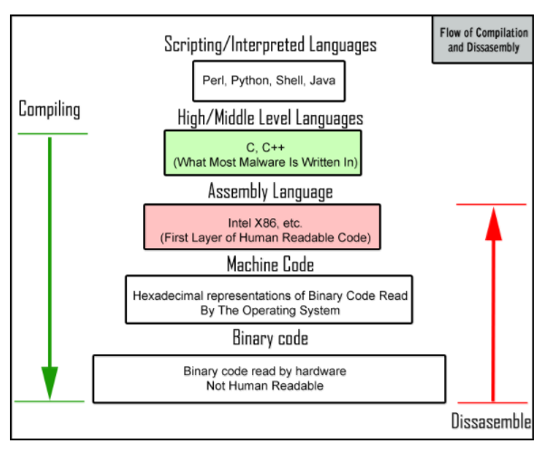
Big Idea

Slide 5
Topics
Part Two: Android NDK (NFC) Development
Electromagnetic induction between two close (4cm) devices
Communicate peer-to-peer, with tag, or as card emulator
Allow part of your app to interface with native-code languages and libraries in C/C++; use java, JNI (java native interface), C/C++, xml
Tools: Eclipse or android studio;
Tools: linux, terminal, or cygwin

Slide 6
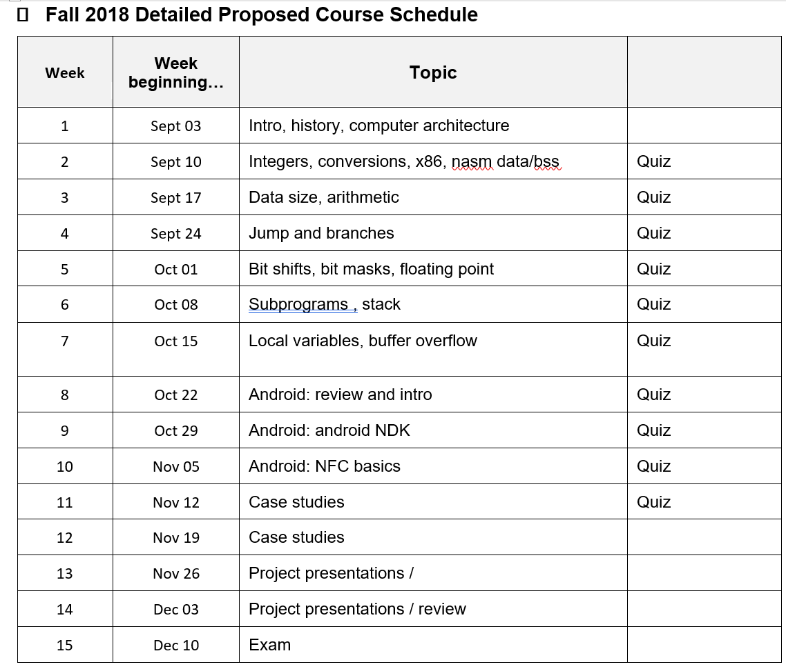
Proposed Schedule

Slide 7
Why?
Quick answer:
Because of Aman, Fortinet, … ☺
Because assembly language directly talks to the computer … this is really cool.
Because Android is the largest market share
Because Near Field Communications is interesting (and you get a free NFC tag)
Deeper answers:
To come…

Slide 8
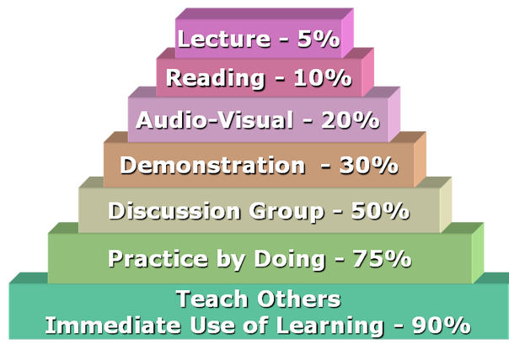
How we’ll learn …
“The Memory Retention Triangle”
Find “smart” ways to learn.
Interactive
Hands-on
Re-enforce
Review

Slide 9
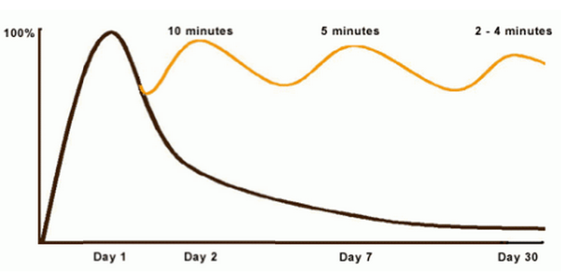
Curve of Forgetting https://uwaterloo.ca/counselling-services/curve-forgetting
Students forget over 50% of what they learn if they don't review within 24 hours.

Slide 10
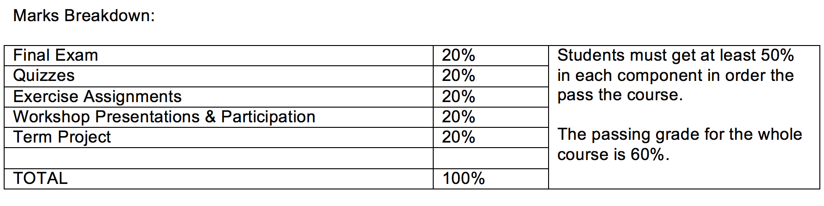
Course Format
Lecture & hands-on exercises & quizzes
Workshop presentations and project
Show me what you have learnt
Marks breakdown:

Slide 11
Workshop Presentations
When: First 10-15 minutes of each class
Why: Demonstrate learning
What: Teams (partners) will present, workshop style. Include these components:
“How To” (problem and solution)
Demo / Hands-on (for presenter and audience)
Both partners participate
Class participate
You decide on content.
Sign up for slot.

Slide 12
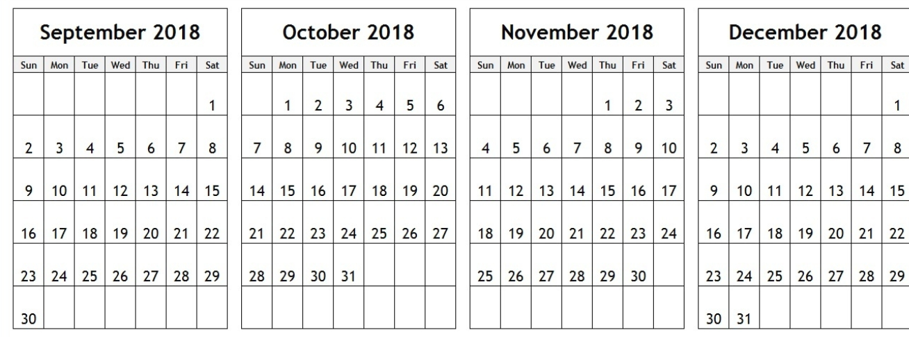
 | Names and Topic
Sept 12
Sept 19
Sept 26
Oct 03
Oct 10
Oct 17
Oct 24
Oct 31
Nov 07
Nov 14
First come
first serve

Slide 13
Typical week:
Classtime:
10-15 min workshop presentations
Questions & discoveries / open to the floor
5 min quiz
New topic for the day
Hands-on lab component (group work)
Head start on homework
Homework:
Review lecture, Read notes
Do exercises (submit in d2l)

Slide 14
Project
Research or Experimental or Eduational
Possible Ideas:
Compare assembly code and efficiencies
Study malware and viruses
Implement an NFC app
Survey of recent NFC research
Security and social issues surround NFC
Deliverable:
One written document (the “paper”).
- Goals, results, summary
- Problem, solution, summary
One presentation (can include demo, results, charts, code-walkthru, etc.)

